Slide 1
Decision Making for a Single Sample
Chapter 4

Slide 2
Statistical Inference
Statistical Inference helps us determine information (like mean, variance) about a population based upon data taken from a sample of size n of that population

Slide 3
Parameter Estimation
The population mean μ is estimated by the point estimate
The population variance σ² is estimated by the point estimate
The proportion of items belonging to a category of interest in a population p is estimated by the point estimate
The difference between the means of two different populations μ₁ − μ₂ is estimated by the point estimate
The difference between the proportions two different populations μ₁ − μ₂ is estimated by the point estimate

Slide 4
Hypothesis Testing
The method of determining if a statement about a population parameter is (likely) true or not

Slide 5
Case I: Hypothesis Testing on the mean (μ) of a population, variance (σ² ) known

Slide 6
Null and Alternative Hypotheses: H₀ and H₁
Null Hypothesis (H₀): The sample is from a population with mean equal to a specific numerical value, μ₀
Alternative Hypothesis (H₁): The sample is from a population with mean NOT equal to that specific numerical value, μ₀
H₀: μ = μ₀ H₀: μ = μ₀ H₀: μ = μ₀
Η₁: μ ≠ μ₀ Η₁: μ < μ₀ Η₁: μ > μ₀
μ₀ is ALWAYS a numerical value, and always appears on the RHS of H₀ and H₁
H₀ is ALWAYS an EQUALITY.
This is a 2-sided test on the mean
This is a 1-sided LOWER test on the mean
This is a 1-sided UPPER test on the mean
We will conclude that there is evidence that H₀ is (likely) TRUE…FAIL TO REJECT H₀ or that there is evidence that H₀ is (likely) FALSE...........................................REJECT H₀

Slide 7
In-Class Demonstration of Hypothesis Testing Case I from Text: Hypothesis Test on the Mean, Std. Dev. Known
You are asked to determine if the population mean height of men, μ, is equal to μ₀ =70 inches (or not) by using a sample size of n = 4 people in IEE 380 . An authority who knows a lot (God, your teacher, historical data, or psychic) tells you that a man’s height, X, is normally distributed with a population mean, μ, that is unknown and a population standard deviation, σ, that is known to be 3 inches:
H₀ : μ = 70 inches
H₁ : μ ≠ 70 inches
Find a sample of n = 4 people and pretend they’re all men, even if they’re not. Make a new friend and introduce yourself.
Record each person’s height, x_{i}, in inches.
Compute the sample mean point estimate of your n = 4 people to three decimal places: :
Compute the numerical value of a standard normal test statistic, z₀ , using your sample mean point estimate, (from 3 above), σ = 3 inches, and n = 4:
If -1.96 < z₀ < 1.96, you will conclude that the mean of this population is equal to 70 inches. That is, you will FAIL TO REJECT THE NULL HYPOTHESIS, H₀: μ = 70 inches.
If z < -1.96 or z₀ > 1.96, you will conclude that the population mean of men’s heights is NOT equal to 70 inches. That is, you will REJECT THE NULL HYPOTHESIS, H₀: μ =70 inches in favor of the alternative hypothesis, H₁: μ ≠ 70 inches.

Slide 8
From this exercise, note that…
…some of you had a point estimate, ,that led you to conclude that μ = 70 inches.
You failed to reject H₀ : μ = 70
…some of you had a point estimate, ,that led you to conclude that μ ≠ 70 inches.
You rejected H₀ : μ = 70
Is μ = 70 inches or not?
We cannot know the TRUE numerical value of m with 100% certainty unless we have ALL of the population values.

Slide 9
Errors in Hypothesis Testing

Slide 10

James Bain
Convicted of kidnapping and rape of a child in 1974.
DNA evidence analyzed in 2009 determined that he could not have committed the crime. He was immediately released from prison.
Jury analogy for hypothesis testing:
H₀ : James Bain is innocent
H₁ : James Bain did it
The 1974 jury REJECTED H₀ when H₀ was TRUE
Type I error is when we REJECT H₀ when H₀ is TRUE: False Negative
Type I error is like convicting an innocent man.
α is the probability of making a Type I error: α = P(Type I error)

Slide 11

Christian Harvey
In 2014, he was recorded trying to hire someone to kill a female prosecutor for $200. He admitted to the crime, but went to trial. The jury found him “not guilty”.
Jury analogy for hypothesis testing:
H₀ : Christian Harvey is innocent
H₁ : Christian Harvey did it
The 2014 jury FAILED TO REJECT H₀ when H₀ was FALSE
Type II error is when we FAIL TO REJECT H₀ when H₀ is FALSE: False Positive
Type II error is like letting a guilty man go free.
β is the probability of making a Type II error: β = P(Type II error)

Slide 12
P(Type I Error): α P(Type II Error): β
Conclusion: We must be willing to assume some risk of error because our point estimate will be different each time we sample.
Type I error : when we reject null hypothesis, H₀ when it is TRUE.
P(Type I error) = P(we reject H₀ when it is true) = α
Type II error: when we fail to reject the null hypothesis, H₀ when it is FALSE.
P(Type II error)= P(we accept H₀ when it is false) = β
Conclusion | H₀ is TRUE | H₀ is FALSE
Fail to reject H₀ | No error | Type II error P(Type II error) = β
Reject H₀ | Type I error P(Type I error) = α | No error

Slide 13
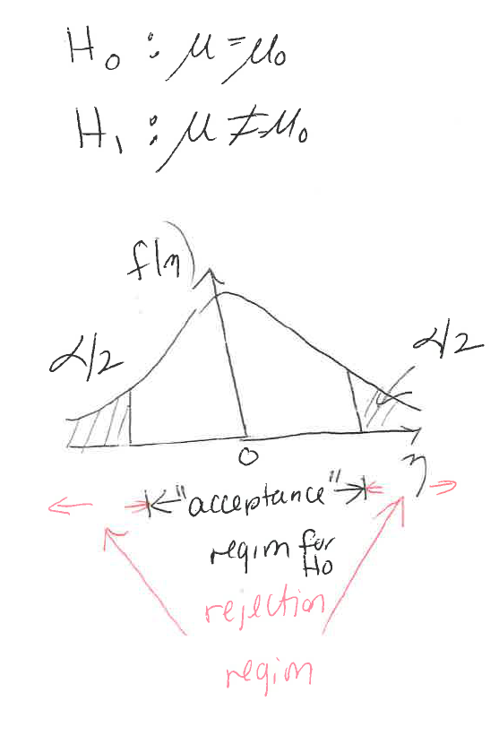
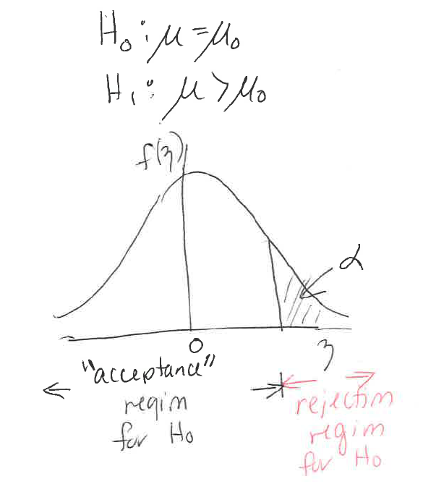
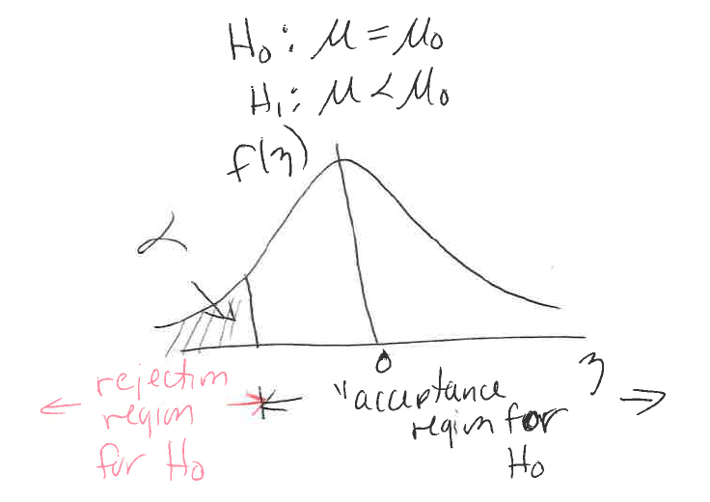
P(Type I Error) = α
Type I (α) error is the probability that the analyst will reject H₀ when it is TRUE
α is selected before a test begins
It is the probability that the test statistic (z₀ ) will fall outside of the “acceptance” region for H₀

Slide 14
Problem
Output voltage is assumed to be normally distributed. The std dev is known to be .25V.
What is the std. dev. of a sample of 10 of these units?
The hypothesis test to determine if the mean is 9V or not is:
H₀ : μ = 9 V
H₁ : μ ≠ 9 V
H₀ will be rejected if a sample mean of 10 units is less than 8.796V or greater than 9.204V. What is the probability of Type I error, α? Answer to three decimal places.

Slide 15
Definitions of
-z_{α} is the numerical value of z such that the area below it is α
z_{α} is the numerical value of z such that the area above it is α
-z_{α/2} is the numerical value of z such that the area below it is α/2
z_{α/2} is the numerical value of z such that the area above it is α/2

Slide 16
Case 1: Test of Hypothesis on μ σ Known
Reject H₀ if z₀ > z_{α/2} Reject H₀ if z₀ > z_{α} Reject H₀ if z₀ < - z_{α}
or if z₀ < - z_{α/2}
p-value = 2[1-φ(|z₀|)] p-value = 1 – φ(z₀) p-value = φ(z₀)
Reject H₀ if p-value is < α
TI-83/84:
STAT→TESTS→1: Z-Test

Slide 17
Two-Sided Confidence Interval on the Population Mean, μ, σ known
For α, determine the numerical values of L and U, symmetric about μ, such that P(L < μ < U) = 1 - α
TI-83/84:
STAT →TESTS →7: ZInterval

Slide 18
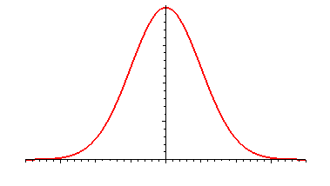
How did we determine L and U?
is the value of -z at which φ(-z) = α/2
is the value of z at which φ(z) = 1- α/2
For α = .05, -z_{.025} = -1.96 and z_{.025} = 1.96
Population standard deviation: σ = 3
.95
So...
.025
.025
L
μ
U
L: lower value
U: Upper value

Slide 19
One-Sided Confidence Interval on the Population Mean μ, σ known
Lower Confidence Interval
Determine L such that P(L < μ ) = 1 - α
Upper Confidence Interval
Determine U such that P(μ < U) = 1 - α

Slide 20
How did we determine L?
For α = .05, z_{.05} = 1.645
.95
So...
.05
L
μ

Slide 21
How did we determine U?
For α = .05, z_{.05} = 1.645
.95
.05
So...
μ
U

Slide 22
Determining the p-value for a hypothesis test
22

Slide 23
p-value
The p- value is an
that you do not choose
Definition: The p value is the value of α that puts you on the borderline between REJECTING H₀ and FAILING TO REJECT H₀
23

Slide 24
Cases 1 and 2: Computing the p-value
Draw the pdf of the random variable (sample mean showing the numerical values of μ₀ and the std. dev. of the sample mean, (Case 1) or sample std. dev., s (Case 2).
Clearly state the null and alternative hypotheses, H₀ and H₁.
Determine the numerical value of the test statistic, z₀ (Case 1) or t₀ (Case 2).
Draw the pdf of Z (Case 1) or T (Case 2).
If you have a two-sided hypothesis test and the test statistic is < 0, the p-value is 2x (area below the test statistic)
If you have a two-sided hypothesis test and the test statistic is > 0, the p-value is 2x (area above the test statistic).
If you have a one-sided upper hypothesis test, the p-value is the area above the test statistic. The test statistic could be < 0 or > 0).
If you have a one-sided lower hypothesis test, the p-value is the area below the test statistic. The test statistic could be < 0 or > 0).
Two-sided
H₀: μ = μ₀
H₁: μ ≠ μ₀
One-sided upper
H₀: μ = μ₀
H₁: μ > μ₀
One-sided lower
H₀: μ = μ₀
H₁: μ < μ₀

Slide 25
p-value Facts
There is one p-value for every hypothesis test
The p-value is solely dependent upon the value of the test statistic, z₀ (or t₀ , or χ²₀ )
If the p-value is smaller than your chosen α, (or just really, really small, like < .01), REJECT H₀
If the p-value is larger than your chosen α (or just really big, like > .10), FAIL TO REJECT H₀
*If the .01 < p-value < .10, then you must choose an α. If this situation is on an exam, I will have to give you an α.

Slide 26
The higher the p- value...
the stronger the evidence for Ho
The smaller the p- value...
the stronger the evidence for H1
26

Slide 27
Hypothesis Testing Algorithm
Step 1: Determine the population parameter that is going to appear in the null and
alternative hypotheses (e.g., μ, σ² , p)
Step 2: Determine the given numerical values in the problem (e.g., α, n, x bar, , σ² , s² )
Step 3: Determine the null and alternative hypotheses.
Step 4: Compute the test statistic (e.g., z₀, t₀, χ²₀).
Step 5: Compare test statistic to threshold values: if H₁ is < or H₁ is > use threshold
values z_{α}, t_{α}, χ_{α}² . If H₁ is ≠, it is a two-sided test, use threshold values z_{α/2}, t_{α/2}, χ_{α/2}² .
Step 6: Draw a picture and then draw a conclusion: Reject H₀ or Fail to Reject H₀.
Alternative to Steps 4, 5 and 6:
Compute p-value for the test.
If p-value > α, Fail to Reject H₀ .
If p-value < α Reject H₀ .

Slide 28
P(Type II Error)=β
β = P(fail to reject H₀ when it is FALSE)
Power = 1 - β
Can only be computed if a (possible) true mean value is provided

Slide 29
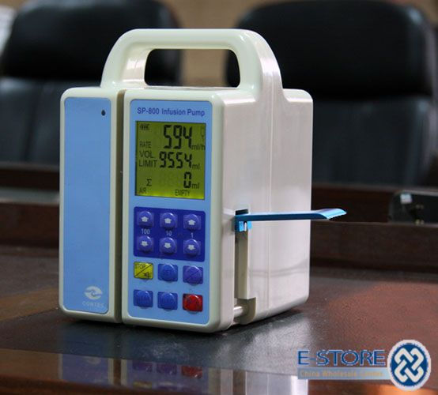
Type II Error Probability: Industrial Engineering Application: Flow Meter Quality Control Problem
An inspector of flow metering devices used to administer fluid intravenously will perform a hypothesis test to determine whether the mean flow rate is different from the flow rate setting of 200 milliliters per hour. Based on prior information the standard deviation of the flow rate is assumed to be known and equal to 12 milliliters per hour. A sample size n = 100 yields a mean of 203 milliliters per hour. Use α = 0.05 to answer the following questions:
1. What is the numerical value of the test statistic for a hypothesis test that the mean flow rate is not equal to 200 milliliters per hour?
2. What is your conclusion? Use the p-value approach.
3. What is the Type II error if the true population mean is 205 milliliters per hour?
Notes:
1. z0 = 2.5 2. Reject H0 3. P(Type II Error) = Βετα = .014

Slide 30
A Little Review
A random variable is a variable that can assume different values or a range of values with a probability (e.g., a man’s height, X)
A function of a random variable(s) is also a random variable. Examples
Z made from men’s heights
The sample mean of men’s heights
Z made from the sample mean of men’s heights)
30

Slide 31
σ², σ, S² and S
S² is the estimate of σ², S is the estimate of σ
S² may be loosely thought of as the average squared distance from the sample average
S² and S are estimators of σ² and σ, respectively.
S² and S are random variables. Why?
31

Slide 32
Case II: Hypothesis tests and confidence intervals on the mean, μ, variance unknown
32

Slide 33
The Student’s T-Distribution
History
33

Slide 34


History
William Sealy Gosset was a chemist and statistician who worked in Dublin at the Guinness brewery in the early 1900’s.
34

Slide 35
He wrote a technical paper for submission to the journal, Biometrika.
The paper was about the distribution of values from small samples of data taken from the brewery.
Guinness had already had their trade secrets compromised earlier when another employee wrote a paper.
Guinness would not let Sealy publish the paper under his own name, so he chose the pseudonym, Student.
35

Slide 36
The Student’s T Distribution
T is a random variable that we will use to analyze the population mean, μ, when the variance (and hence, standard deviation) are unknown.
S is the sample standard deviation
n is the number of items in the sample
T is said to have a t-distribution (i.e., pdf)with ν= n-1 degrees of freedom
Sometimes it is called the Student’s t-distribution
36

Slide 37
Computing s
Learn the stat function on your calculator that computes s for a sample size n
Find s for this sample of size n = 6: {1, 2, 3, 4, 5, 6}
TI 83/84: STAT → EDIT → STAT → CALC →1-VAR STATS
37

Slide 38
Student’s T-Distribution
This is the Gamma function
Probability Density Function (pdf)
This is the t-distribution's pdf
Cumulative Density Function (CDF)
This is the t-distribution's CDF
*Good news! You can forget these equations.
Somebody made a table for you.
38

Slide 39
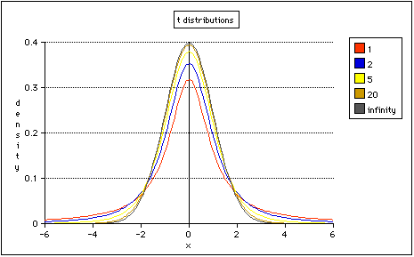
Plot of the t-distribution
Different values of
ν = n−1, the degrees of freedom.
f(t)
t
39

Slide 40
Anyway, back to T
T is used to analyze the population mean, μ, when the variance (and hence, standard deviation) are unknown.
S is the sample standard deviation
is the sample mean
n is the number of items in the sample
T is said to have a t-distribution (i.e., pdf)with ν= n-1 degrees of freedom
What are
"Degrees of Freedom"?
E(T) = μ = 0
40

Slide 41
Explanation of ν: Degrees of Freedom (also called df)
Example: Sample size n = 3 is taken and values x₁ = 2.1, x₂ = 3.0, and x₃ = 4.2 are obtained. Sample mean is x = (x₁ + x₂ + x₃ )/n = (2.1 + 3.0 + 4.2)/3 = 3.1
The sum of the deviations of each x_{i} from the sample mean must equal 0. Proof:
We know the numeric value of the sample mean. We need only know 2 = 3-1 = n – 1 (df) values of x in order to determine the numeric value of s, the sample standard deviation:
x_{i} | x_{i} - xbar
2.1 | 2.1 - 3.1 = -1
?? | ?? – 3.1 =
4.2 | 4.2 - 3.1=1.1
We don’t need to know what x_{i} is to know that this value here has to be - .1. We have 3-1 degrees of freedom here, meaning, 2 values are “Free” to be can be any value at all, but the third value is not.
The T statistic uses s. Therefore, T has n-1 degrees of freedom.
41

Slide 42
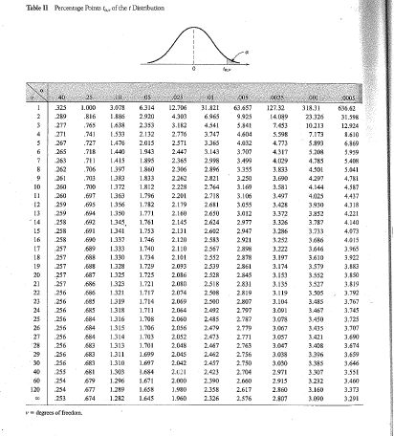
The T-Table Appendix A Table II in text

Slide 43
Practice
What is the probability that a T random variable with 12 degrees of freedom is bigger than 2.179?
What is the probability that a T random variable with 8 degrees of freedom is less than .706?
What is the probability that a T random variable with 4 degrees of freedom lies between -2.776 and 2.776?
Solve for A: P(Z > A) = .05
Solve for B if T has 120 degrees of freedom: P(T > B) = .05

Slide 44
Twizzlers Weight Variance Unknown μ = 12 grams n = 4
Sample index | x1 | x2 | x3 | x4 | Sample Mean | Sample Variance | Sample Std. Dev. | t
1 | 11.1 | 12.6 | 11.8 | 12.2 | 11.925 | 0.409 | 0.640 | -0.234 |  | t1
2 | 12.2 | 12.1 | 11.9 | 12.3 | 12.125 | 0.029 | 0.171 | 1.464 |  | t2
3 | 12.9 | 11.4 | 12.3 | 12.1 | 12.175 | 0.383 | 0.618 | 0.566 |  | t3
4 | 11.5 | 11.4 | 12.2 | 11.8 | 11.725 | 0.129 | 0.359 | -1.530 |  | t4
.
.
198 | 12.4 | 11.2 | 11.7 | 12.1 | 11.85 | 0.270 | 0.520 | -0.577 |  | t198
.
.
The sample variance, S² , sample std. dev., S,
are random variables and so is T.
44

Slide 45
Hypothesis Tests And Confidence Intervals on μ, Variance Unknown
45

Slide 46
Definitions of
-t_{α,n-1} is the numerical value of t_{n-1} such that the area below it is α
t_{α, n-1} is the numerical value of t_{n-1} such that the area above it is α
-t_{α/2, n-1} is the numerical value of t_{n-1} such that the area below it is α/2
t_{α/2,n-1} is the numerical value of t_{n-1} such that the area above it is α/2

Slide 47
Case 2: Test of Hypothesis on μ σ Unknown
Reject H₀ if t₀ > t_{α/2, n-1} Reject H₀ if t₀ > t_{α, n-1} Reject H₀ if t₀ < - t_{α, n-1}
or if t₀ < - t_{α/2, n-1}
** Using table, range on the P-value can found. Using calculator, exact P-value can be found. ***
Reject H₀ if p-value is < α
TI-83/84:
STAT→TESTS→2: T-Test

Slide 48
Two-Sided Confidence Interval on the Population Mean, μ, σ Unknown
For α, determine the numerical values of L and U, symmetric about μ, such that P(L < μ < U) = 1 - α
TI-83/84:
STAT →TESTS →8: TInterval

Slide 49
One-Sided Confidence Interval on the Population Mean μ, σ Unknown
Lower Confidence Interval
Determine L such that P(L < μ ) = 1 - α
Upper Confidence Interval
Determine U such that P(μ < U) = 1 - α

Slide 50
Case 2:Computing the p-value
Draw the pdf of the sample mean showing the numerical values of μ₀ and the std. dev. of the sample mean,
Clearly state the null and alternative hypotheses, H₀ and H₁.
Determine the numerical value of the test statistic, t₀ .
Draw the pdf of T (recall that the mean is = 0)
If you have a two-sided hypothesis test and the test statistic is < 0, the p-value is 2x (area below the test statistic)
If you have a two-sided hypothesis test and the test statistic is > 0, the p-value is 2x (area above the test statistic).
If you have a one-sided upper hypothesis test, the p-value is the area above the test statistic. The test statistic could be < 0 or > 0).
If you have a one-sided lower hypothesis test, the p-value is the area below the test statistic. The test statistic could be < 0 or > 0).
Two-sided
H₀: μ = μ₀
H₁: μ ≠ μ₀
One-sided upper
H₀: μ = μ₀
H₁: μ > μ₀
One-sided lower
H₀: μ = μ₀
H₁: μ < μ₀

Slide 51
P-Value
Recall that the p-value is the smallest α such that H₀ is rejected
Tricky to compute exactly with T
There are only ten (10) probability values computed in the t-table (Table II)
.40, .25, .10, .05, .025, .01, .005, .0025, .001, .0005
* There are 600 probabilities in the Z-table (Table I)
By hand, we can get a bound on the p-value using Table II
51

Slide 52
Case III: Hypothesis tests and confidence intervals on the population variance, σ²
52

Slide 53
χ² Statistic
χ² is a statistic we will use to do hypothesis tests and confidence intervals on the population variance, σ²
S² is the sample variance
n is the number in the sample
is distributed χ² with
n-1 degrees of freedom
53

Slide 54
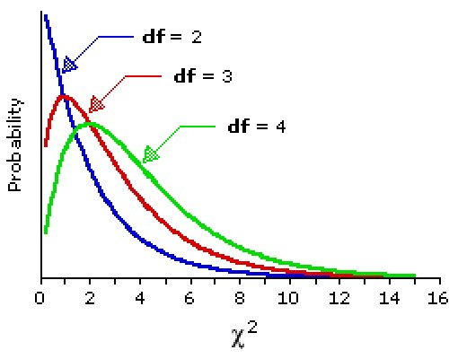
χ² pdf
df = n-1
f(x)
54

Slide 55
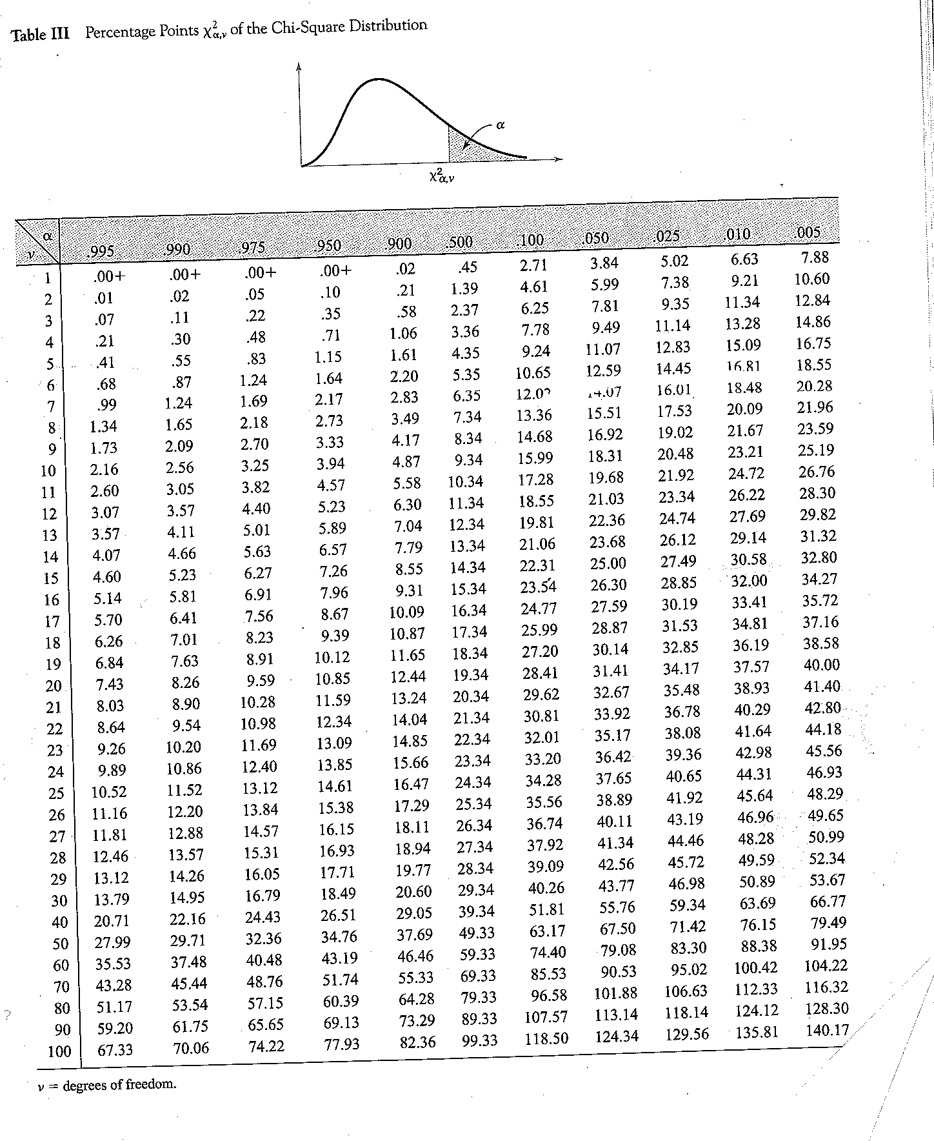
Table III in Appendix A

Slide 56
Chi-Square χ² Table Practice
What is the probability that a χ² random variable with 9 degrees of freedom is bigger than 3.33?
What is the probability that a χ² random variable with 21 degrees of freedom is less13.24?
What is the probability that a χ² random variable with 5 degrees of freedom lies between .41 and 16.75?
For a χ² random variable with 14 degrees of freedom, find A such that
P(A < χ² < 26.12) = .95

Slide 57
Definitions of
is the numerical value of such that the area above it is α
is the numerical value of such that the area above it is 1- α
is the numerical value of such that the area above it is α/2
is the numerical value of such that the area above it is 1 - α/2

Slide 58
Case 3: Test of Hypothesis on σ or σ²
There is no stats function for this test on the TI-83/84.
Really.
The thing called “Chi Square Test” on the TI-83/84 is NOT this.
Reject H₀ if p-value is < α
** Using table, range on the p-value can found. Using calculator, exact P-value can be found. ***

Slide 59

Two-Sided Confidence Interval on the Population Variance σ²
For α, determine the numerical values of L and U, symmetric about σ² , such that P(L < σ² < U) = 1 - α
There is not a stats function for these computations on the TI-83/84.

Slide 60
One-Sided Confidence Interval on the Population Variance σ²
Lower Confidence Interval
determine the numerical value of L such that P(L < σ² ) = 1 - α
Upper Confidence Interval
For α, determine the numerical value of U such that P( σ² < U) = 1 - α

Slide 61
Case 3: Computing the p-value
Clearly state the null and alternative hypotheses, H₀ and H₁.
Determine the numerical value of the test statistic, χ₀²
3. Plot the pdf of χ² (Recall that the lowest value is 0)
If you have a two-sided hypothesis test and the test statistic is “closer to zero than to the right tail of the pdf” the p-value is 2x (area below the test statistic)
If you have a two-sided hypothesis test and the test statistic is “closer to the right tail of the pdf” the p-value is 2x (area above the test statistic).
If you have a one-sided upper hypothesis test, the p-value is the area above the test statistic.
If you have a one-sided lower hypothesis test, the p-value is the area below the test statistic.
Two-sided
One-sided upper
One-sided lower

Slide 62
Case IV: Hypothesis tests and confidence intervals on the proportion, p, of a population
62

Slide 63
Recall the Binomial pmf
n is the number of trials
p is the probability of “success”
We could also think of p as the proportion of items that are “successful”
X is the number of successes in n trials
E(X) = np V(X) =np(1-p)
63

Slide 64
Z
Standard Deviation
We can create another Z using the information from the Binomial
64

Slide 65
Case 4: Test of Hypothesis on p (proportion)
Reject H₀ if z₀ > z_{α/2} Reject H₀ if z₀ > z_{α} Reject H₀ if z₀ < - z_{α}
or if z₀ < - z_{α/2}
p- value = 2[1-φ(|z₀|)] p-value = 1 – φ(z₀) p-value = φ(z₀)
Reject H₀ if p-value is < α
TI-83/84:
STAT→TESTS→5: 1-PropZTest

Slide 66
Two-Sided Confidence Interval on the Proportion p
For α, find L and U such that P(L < p < U) = 1 - α
TI-83/84:
STAT →TESTS →A: 1-PropZInt
66

Slide 67
One-Sided Confidence Intervals on the Proportion p
For α, find L such that P(L < p) = 1- α
For α, find U such that P(p < U) = 1- α
67

Slide 68
Case 4:Computing the p-value
Clearly state the null and alternative hypotheses, H₀ and H₁.
Determine the numerical value of the test statistic, z₀ .
Draw the pdf of Z, the standard normal random variable
If you have a two-sided hypothesis test and the test statistic is < 0, the p-value is 2x (area below the test statistic)
If you have a two-sided hypothesis test and the test statistic is > 0, the p-value is 2x (area above the test statistic).
If you have a one-sided upper hypothesis test, the p-value is the area above the test statistic. The test statistic could be < 0 or > 0).
If you have a one-sided lower hypothesis test, the p-value is the area below the test statistic. The test statistic could be < 0 or > 0).
Two-sided
H₀: p = p₀
H₁: p ≠ p₀
One-sided upper
H₀: p = p₀
H₁: p > p₀
One-sided lower
H₀: p = p₀
H₁: p < p₀

Slide 69
P-value Facts Summary
If p-value > α, fail to reject H₀
If no α is provided and p-value > .10, fail to reject H₀
If p-value < α, reject H₀
If no α is provided and p-value < .01, reject H₀
If H₁ is the > form, the p-value is the area under the pdf ABOVE the test statistic.
If H₁ is the < form, the p-value is the area under the pdf BELOW the test statistic.
If H₁ is the ≠ form, the p-value is
2X the area under the pdf ABOVE the test statistic if the test statistic is > 0 or
2X the area under the pdf BELOW the test statistic if the test statistic is < 0.
.

Slide 70
Chapter 4 Summary
 | Case 1 | Case 2 | Case 3 | Case 4
Null Hypothesis | H₀ : μ = μ₀ | H₀ : μ = μ₀ | H₀ : σ² = σ² ₀ | p = p₀
Test statistic
2-Sided Confidence Interval

